Slide 1

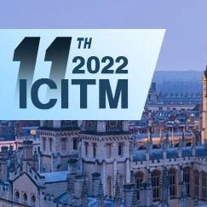

Data Driven Control Based on DQN Algorithm for Path Following of a Ship
by
Sivaraman Sivaraj (MS Scholar)
Suresh Rajendran (Assistant Professor)
Department of Ocean Engineering
IIT Madras, INDIA.
ICITM 2022, Oxford, UK
Slide 1/15
Date :18 /02/2022

Slide 2
Objectives :
Develop a ship navigation model based on a deep reinforcement learning for the heading control and path following of a KVLCC2 tanker in calm water.
Scope :
Numerical development of a 3DoF manoeuvring model for ship dynamics
Implementing the DQN algorithm for ship navigation
Formulation of appropriate reward functions and other hyper parameters
Testing the DQN algorithm for ship heading control in calm water
Testing the DQN algorithm for path following control in calm water.
ICITM 2022, Oxford, UK
Slide 2/15
Date :18 /02/2022

Slide 3
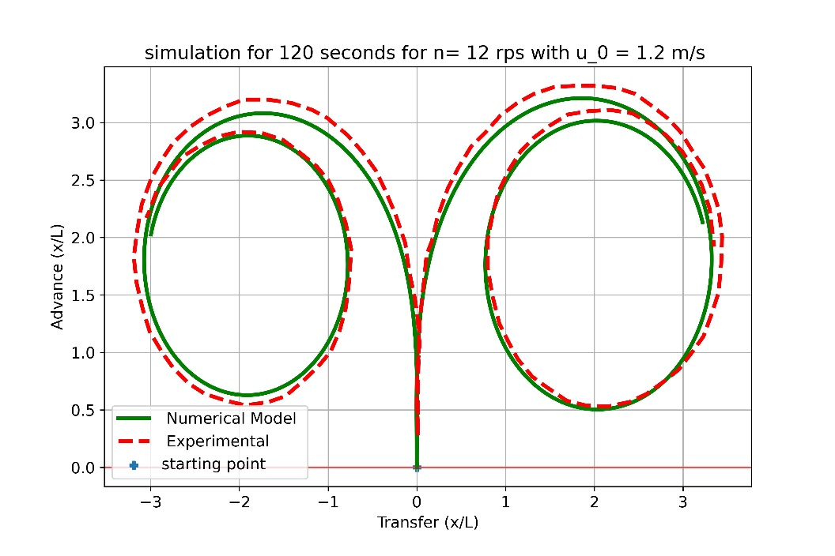
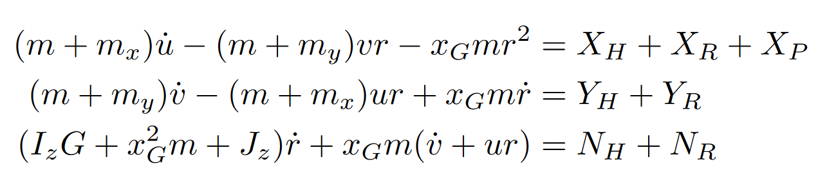
System Dynamics and Modelling
Governing Equation :
ICITM 2022, Oxford, UK
Slide 3/15
Date :18 /02/2022

Slide 4
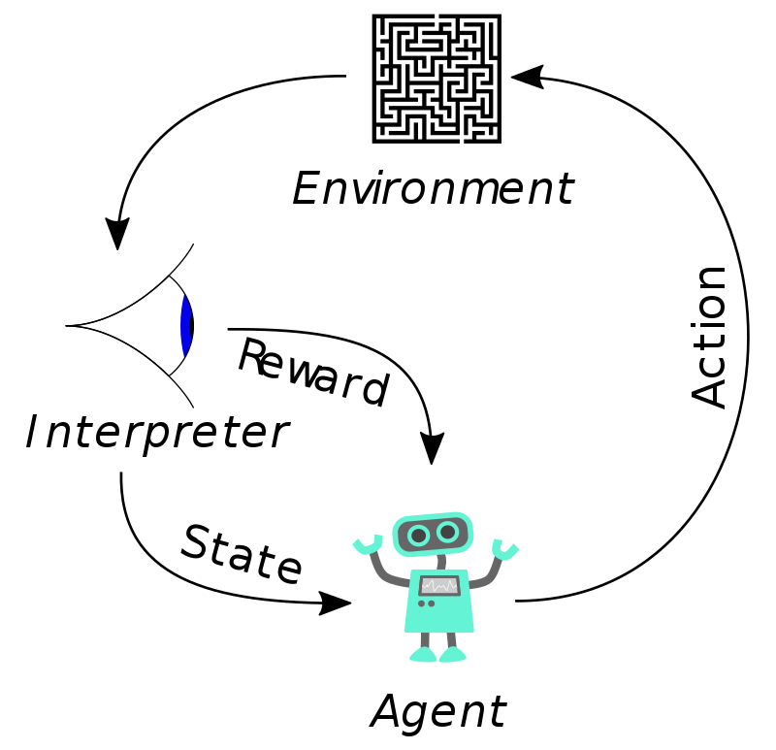
Reinforcement Learning:
Image Reference : Wikipedia
RL is an one of the three ML Paradigms.
Based on the reward, agent will take optimal action.
Depending on the problem setup, State and Action spaces may be in continuous or discrete.
Trade off between Exploitation and Exploration will be the key to Agent Learning rate.
Control System, Controller, Control Signal → → → → Environment, Agent, Action
ICITM 2022, Oxford, UK
Slide 4/15
Date :18 /02/2022

Slide 5
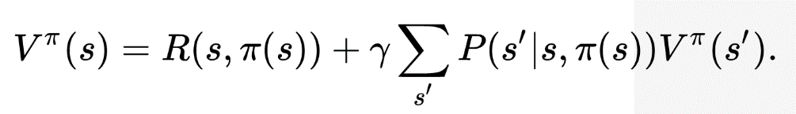
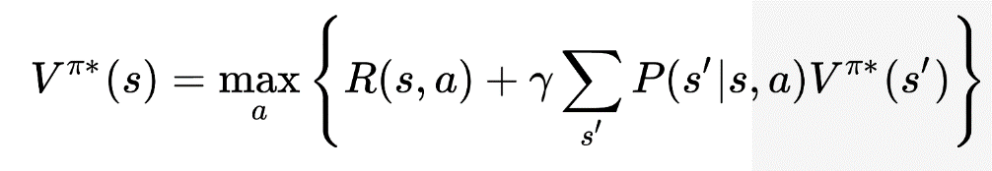
Bellman Equation & Role of DQN Algorithms
Bellman Equation:
Notations
S : state
S’ : next state
a : action(π(s))
π : policy
π* : optimal policy
P(s’|s,a) : probability of taking a action
Bellman optimality equation:
When there is no information about probability ? RL Algorithms help to solve this problem (i.e. Q-Learning, SARSA, Policy Gradient)
When the Number states are higher(i.e. 10^90, 10^8000) ? DRL Algorithms help to solve this problem (i.e. Actor-critic, A3C,DDPG)
Roll No : OE19S012
MS Seminar – Slide 6
Date : 21/01/2022
Oceans 2022, Chennai, INDIA
Slide 5/15
Date : 21/02/2022

Slide 6
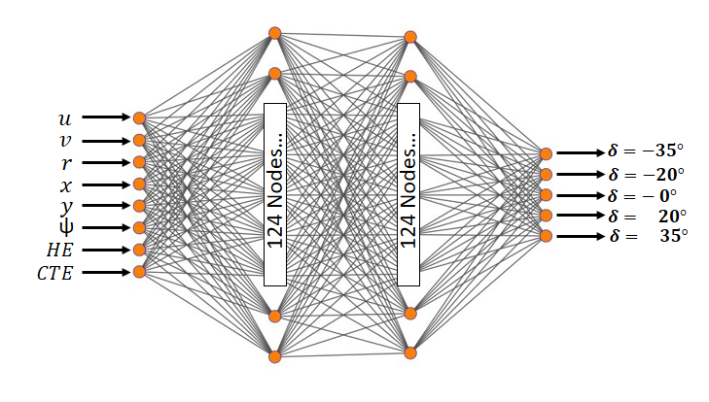
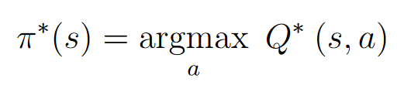

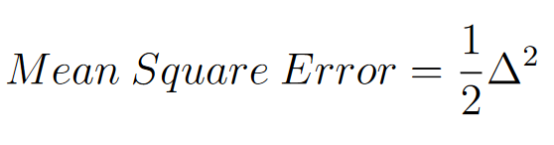
Deep Q-Networks
ICITM 2022, Oxford, UK
Slide 6/15
Date :18 /02/2022

Slide 7
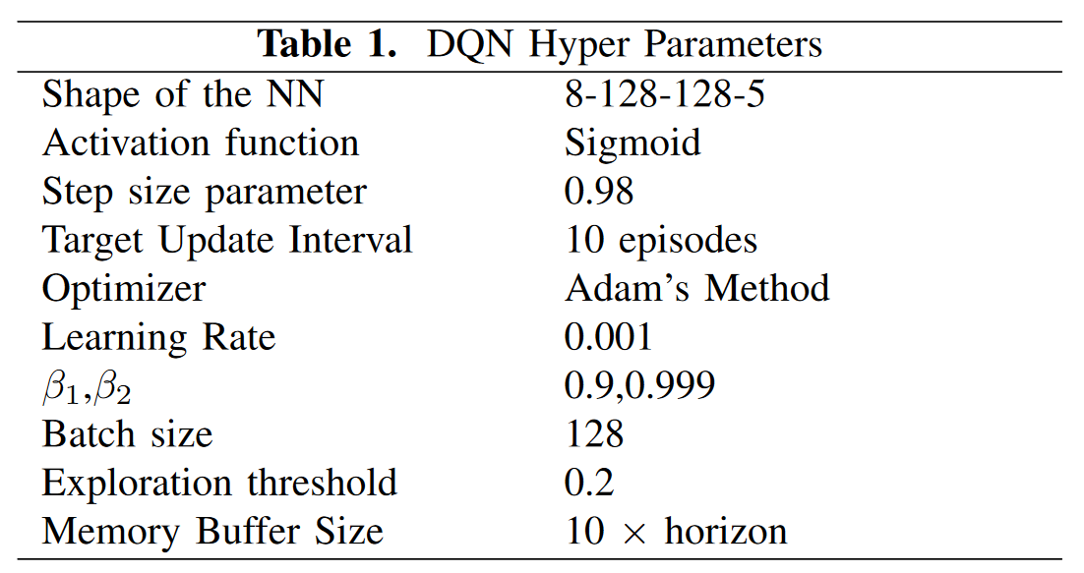
Deep Hyper Parameters
ICITM 2022, Oxford, UK
Slide 7/15
Date :18 /02/2022

Slide 8
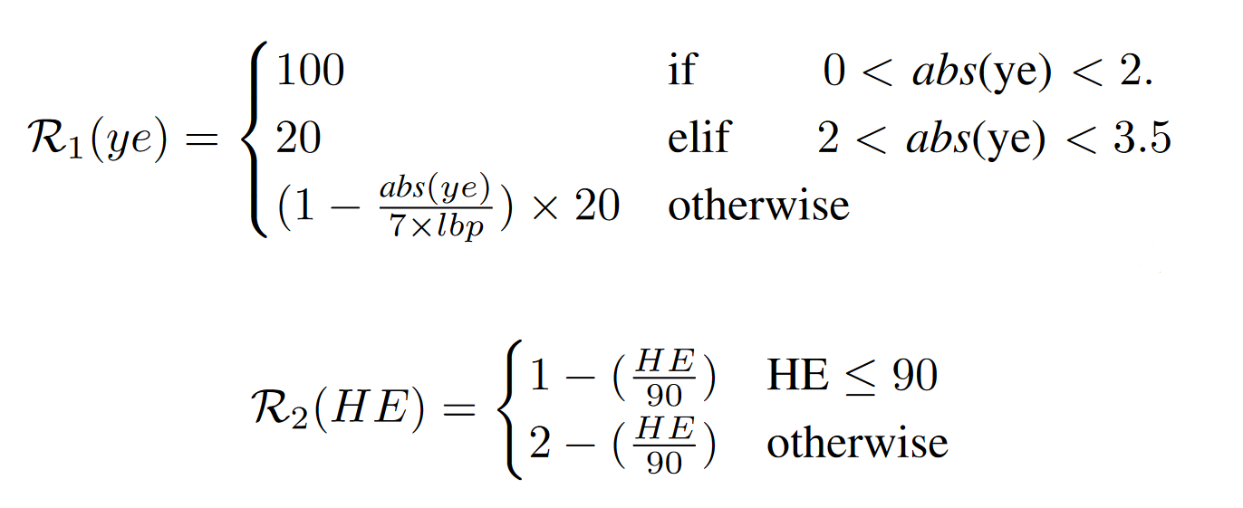
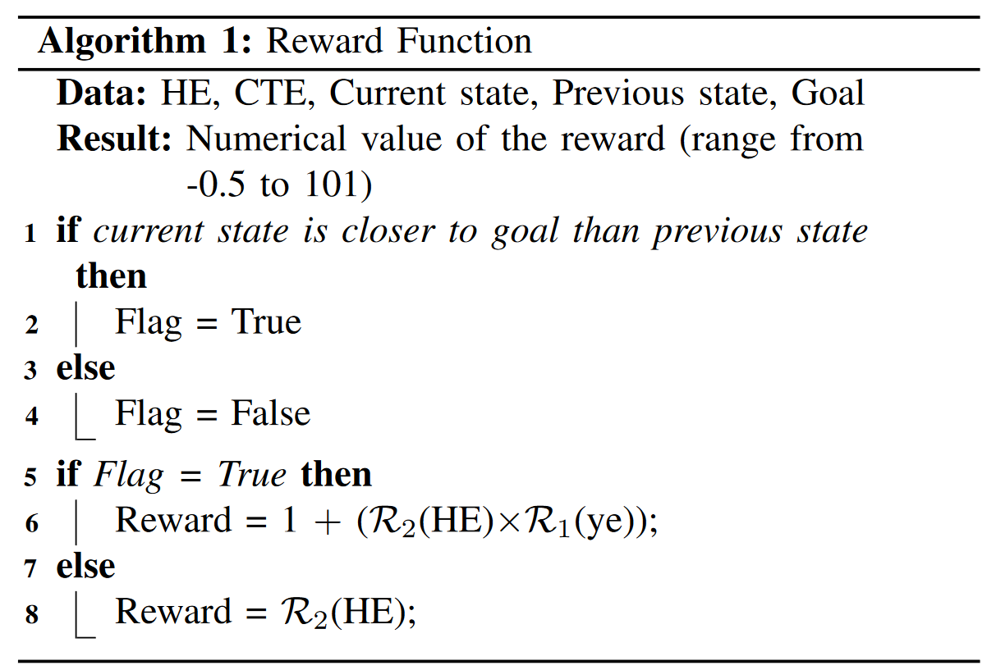
Reward Function
ICITM 2022, Oxford, UK
Slide 8/15
Date :18 /02/2022

Slide 9
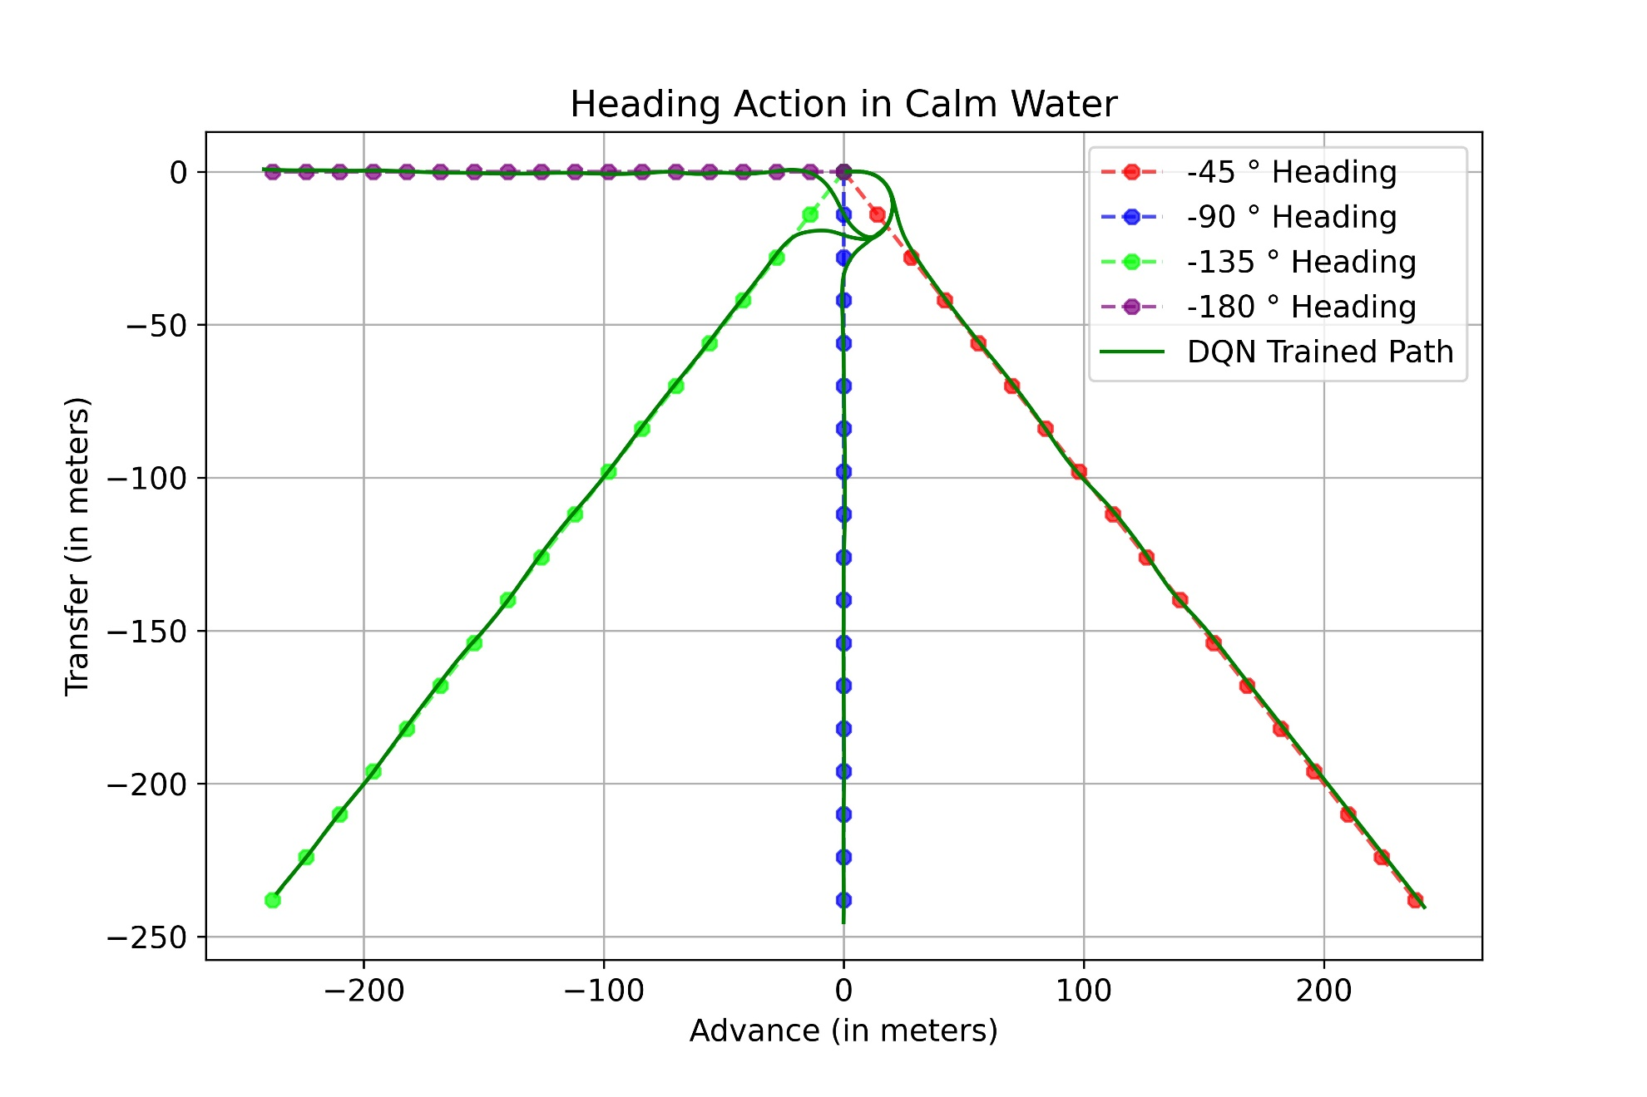
Heading Control in Calm Water
ICITM 2022, Oxford, UK
Slide 9/15
Date :18 /02/2022

Slide 10
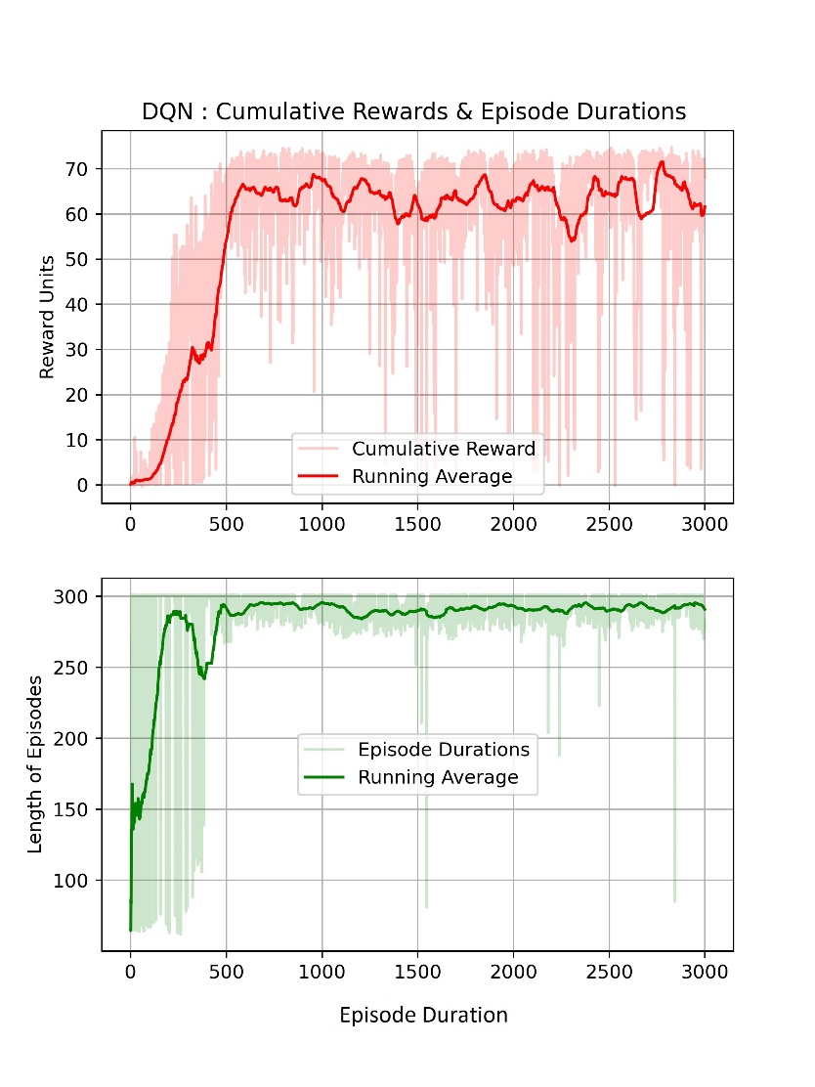
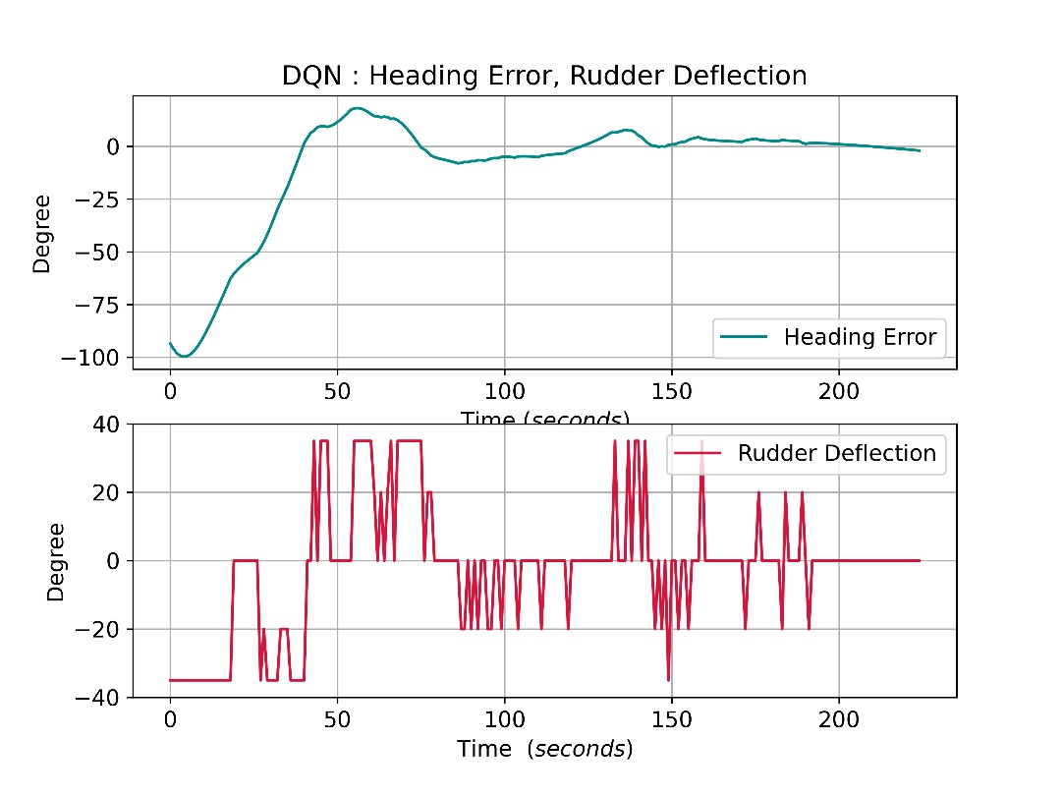
Reward, Number of Episodes, Heading Error and Rudder Action Plots
For -90 degree Heading Action
ICITM 2022, Oxford, UK
Slide 10/15
Date :18 /02/2022

Slide 11
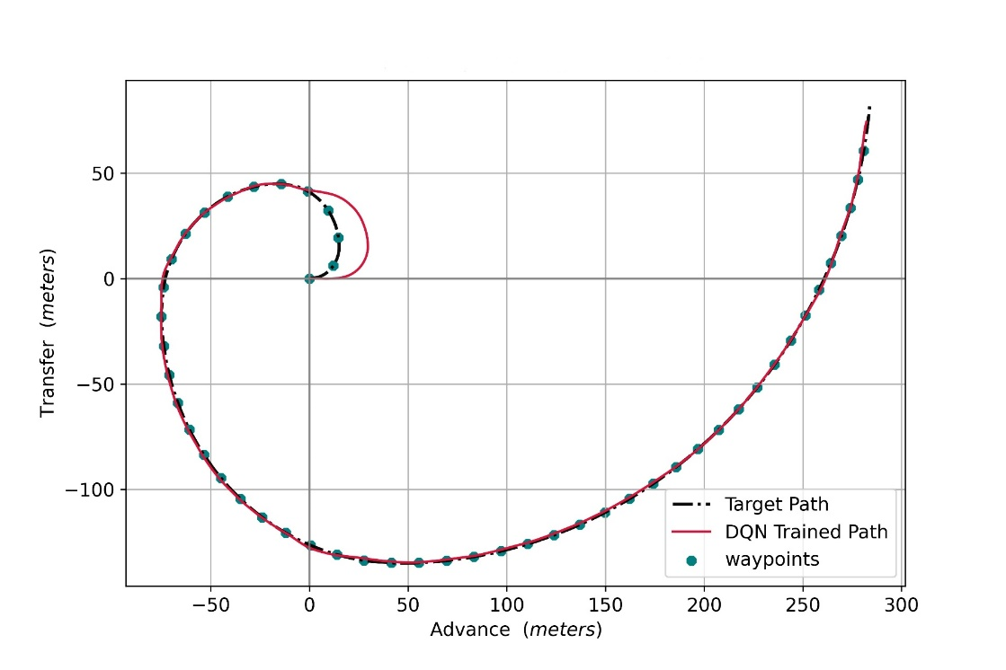
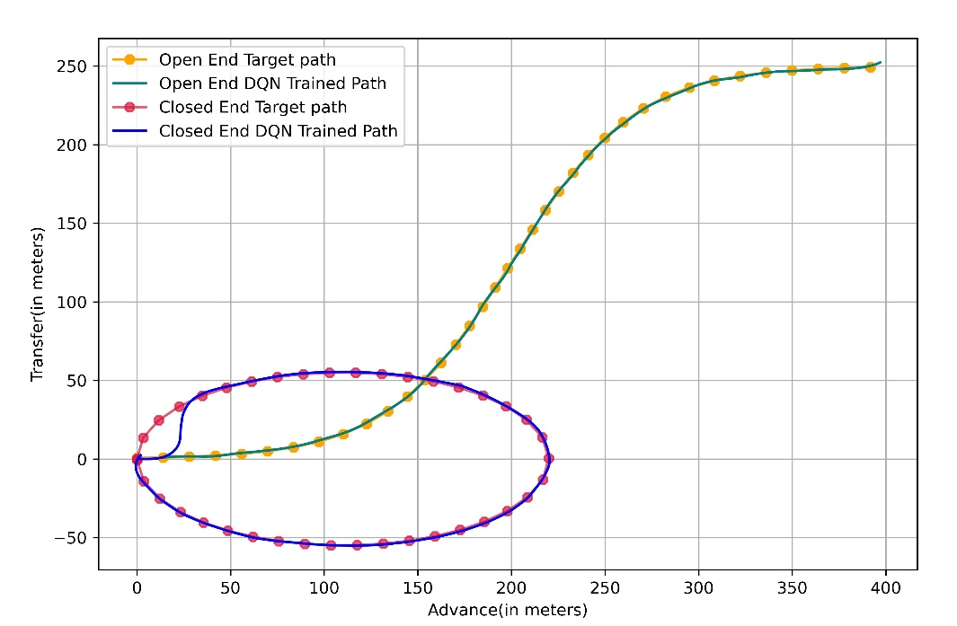
Path Following in Calm Water
The waypoints are kept in a distance of 2 lbp.
ICITM 2022, Oxford, UK
Slide 11/15
Date :18 /02/2022

Slide 12
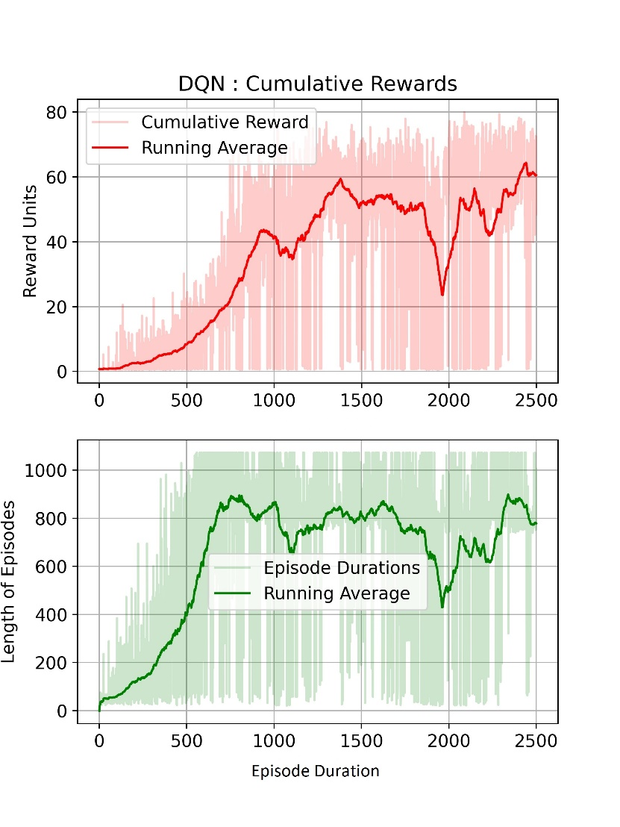
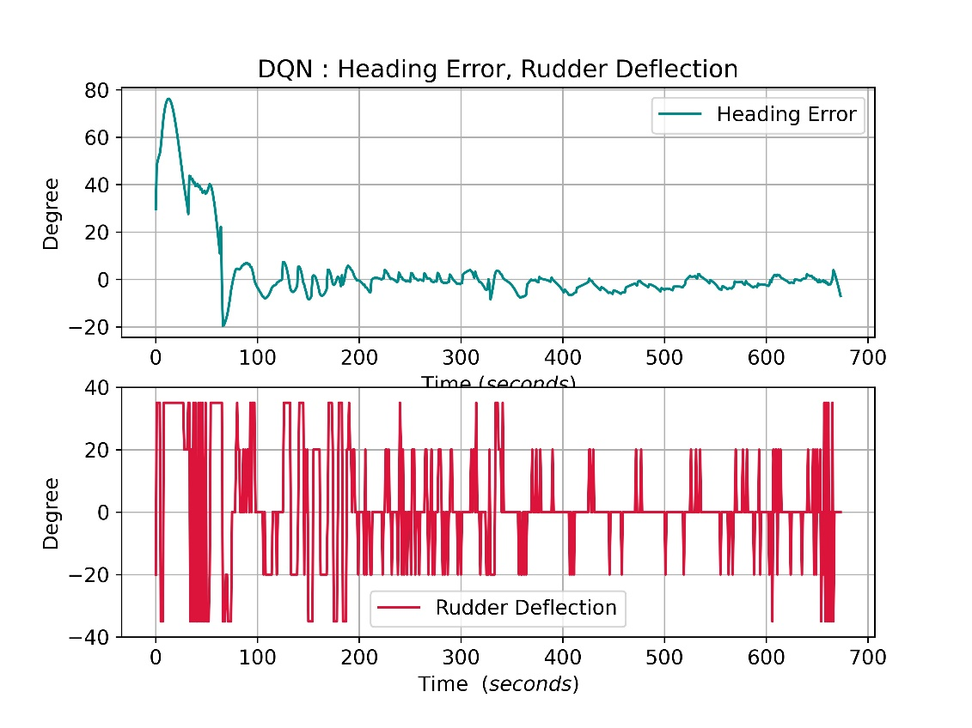
Reward, Number of Episodes, Heading Error and Rudder Action Plots
For path following
ICITM 2022, Oxford, UK
Slide 12/15
Date :18 /02/2022

Slide 13
Conclusion
A DQN based Reinforcement Learning algorithm is developed for the heading control and path following of a tanker in calm water.
A 3DoF nonlinear manoeuvring model is used to represent the vessel dynamics and Line of Sight (LoS) algorithm is used for the vessel guidance.
The reward function and the termination criterion are appropriately modelled so that the vessel smoothly converges to the desired track.
ICITM 2022, Oxford, UK
Slide 13/15
Date :18 /02/2022

Slide 14
Conclusion
The heading control using DQN is tested for different vessel headings (45,90,135 and 180 degrees).
The path following using DQN is tested for a curve which is in all four quadrants.
The designed DQN based control has successfully performing the heading action and path follwing in calm water.
ICITM 2022, Oxford, UK
Slide 14/15
Date :18 /02/2022

Slide 15
Thanks…!
ICITM 2022, Oxford, UK
Slide 15/15
Date :18 /02/2022

